Slide 1
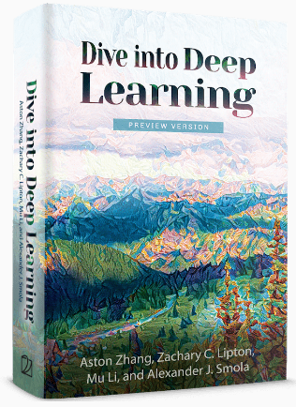
Dive into Deep Learning
Chapter 3:
Linear Neural Networks The Image Classification Dataset

Slide 2
Contents
Linear Regression
Generating the Dataset
Reading the Dataset
Concise Implementation of Linear Regression
Generating the Dataset
Implementation of Softmax Regression from Scratch
Concise Implementation of Softmax Regression
The Image Classification Dataset
Linear Regression Implementation from Scratch
Initializing Model Parameters
Defining the Model
Initializing Model Parameters
Basic Elements of Linear Regression
Vectorization for Speed
The Normal Distribution and Squared Loss
From Linear Regression to Deep Networks
Reading the Dataset
Defining the Loss Function
Reading the Dataset
Reading a Minibatch
Putting All Things Together
Initializing Model Parameters
Defining the Softmax Operation
Defining the Model
Defining the Loss Function
Initializing Model Parameters
Softmax Implementation Revisited
Optimization Algorithm
Defining the Optimization Algorithm
Softmax Regression
Classification Problem
Network Architecture
Softmax Operation
Vectorization for Minibatches
Loss Function
Information Theory Basics
Defining the Model
Defining the Loss Function
Defining the Optimization Algorithm
Training
Training
Model Prediction and Evaluation
Classification Accuracy
Training
Prediction
Training

Slide 3
Contents
CH2
Linear Regression
Linear Regression Implementation from Scratch
Concise Implementation of Linear Regression
Softmax Regression
The Image Classification Dataset
Implementation of Softmax Regression from Scratch
Concise Implementation of Softmax Regression
Basic Elements of Linear Regression
Generating the Dataset
Generating the Dataset
Classification Problem
Reading the Dataset
Initializing Model Parameters
Initializing Model Parameters
Vectorization for Speed
Reading the Dataset
Reading the Dataset
Network Architecture
Reading a Minibatch
Defining the Softmax Operation
Softmax Implementation Revisited
The Normal Distribution and Squared Loss
Initializing Model Parameters
Defining the Model
Softmax Operation
Putting All Things Together
Defining the Model
Optimization Algorithm
From Linear Regression to Deep Networks
Defining the Model
Initializing Model Parameters
Vectorization for Minibatches
Defining the Loss Function
Training
Defining the Loss Function
Defining the Loss Function
Loss Function
Classification Accuracy
Defining the Optimization Algorithm
Defining the Optimization Algorithm
Information Theory Basics
Training
Training
Training
Model Prediction and Evaluation
Prediction

Slide 4
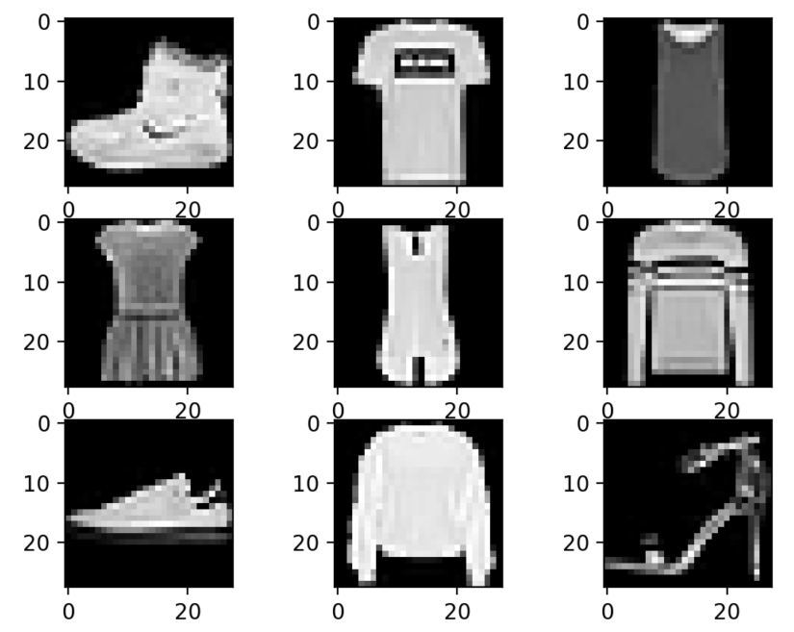
The Image Classification Dataset
One of the widely used dataset for image classification is the MNIST dataset.
Simple models achieve classification accuracy over 95%, making it unsuitable for distinguishing between stronger models and weaker ones.
We will focus on the qualitatively similar, but comparatively complex Fashion-MNIST dataset.
%matplotlib inline
from d2l import mxnet as d2l
from mxnet import gluon
import sys d2l.use_svg_display()

Slide 5
Contents
CH2
Linear Regression
Linear Regression Implementation from Scratch
Concise Implementation of Linear Regression
Softmax Regression
The Image Classification Dataset
Implementation of Softmax Regression from Scratch
Concise Implementation of Softmax Regression
Basic Elements of Linear Regression
Generating the Dataset
Generating the Dataset
Classification Problem
Reading the Dataset
Initializing Model Parameters
Initializing Model Parameters
Vectorization for Speed
Reading the Dataset
Reading the Dataset
Network Architecture
Reading a Minibatch
Defining the Softmax Operation
Softmax Implementation Revisited
The Normal Distribution and Squared Loss
Initializing Model Parameters
Defining the Model
Softmax Operation
Putting All Things Together
Defining the Model
Optimization Algorithm
From Linear Regression to Deep Networks
Defining the Model
Initializing Model Parameters
Vectorization for Minibatches
Defining the Loss Function
Training
Defining the Loss Function
Defining the Loss Function
Loss Function
Classification Accuracy
Defining the Optimization Algorithm
Defining the Optimization Algorithm
Information Theory Basics
Training
Training
Training
Model Prediction and Evaluation
Prediction

Slide 6
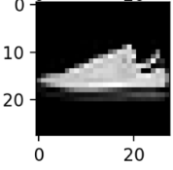
Reading the Dataset
We can download and read the Fashion-MNIST dataset into memory via the build-in functions in the framework.
mnist_train = gluon.data.vision.FashionMNIST(train=True)
mnist_test = gluon.data.vision.FashionMNIST(train=False)
Fashion-MNIST consists of images from 10 categories, each represented by 60000 images in the training dataset and by 10000 in the test dataset.
A test dataset (or test set) is used for evaluating model performance and not for training.
Consequently the training set and the test set contain 60000 and 10000 images, respectively.
len(mnist_train), len(mnist_test)
The height and width of each input image are both 28 pixels.
The dataset consists of grayscale images, whose number of channels is 1.
mnist_train[0][0].shape

Slide 7
Reading the Dataset
The images in Fashion-MNIST are associated with the text categories: t-shirt, trousers, pullover, …
The following function converts between numeric label indices and their names in text.
def get_fashion_mnist_labels(labels): #@save
"""Return text labels for the Fashion-MNIST dataset."""
text_labels = ['t-shirt', 'trouser', 'pullover', 'dress', 'coat',
'sandal', 'shirt', 'sneaker', 'bag', 'ankle boot']
return [text_labels[int(i)] for i in labels]
Create a function to visualize these examples.
def show_images(imgs, num_rows, num_cols, titles=None, scale=1.5): #@save
"""Plot a list of images."""
figsize = (num_cols * scale, num_rows * scale)
_, axes = d2l.plt.subplots(num_rows, num_cols, figsize=figsize)
axes = axes.flatten()
for i, (ax, img) in enumerate(zip(axes, imgs)):
ax.imshow(img.asnumpy())
ax.axes.get_xaxis().set_visible(False)
ax.axes.get_yaxis().set_visible(False)
if titles:
ax.set_title(titles[i])
return axes

Slide 8
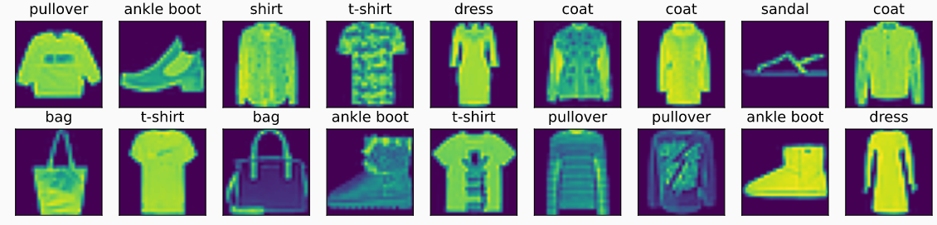
Reading the Dataset
Here are the images and their corresponding labels (in text) for the first few examples in the training dataset.
X, y = mnist_train[:18]
print(X.shape)
show_images(X.squeeze(axis=-1), 2, 9, titles=get_fashion_mnist_labels(y))

Slide 9
Contents
CH2
Linear Regression
Linear Regression Implementation from Scratch
Concise Implementation of Linear Regression
Softmax Regression
The Image Classification Dataset
Implementation of Softmax Regression from Scratch
Concise Implementation of Softmax Regression
Basic Elements of Linear Regression
Generating the Dataset
Generating the Dataset
Classification Problem
Reading the Dataset
Initializing Model Parameters
Initializing Model Parameters
Vectorization for Speed
Reading the Dataset
Reading the Dataset
Network Architecture
Reading a Minibatch
Defining the Softmax Operation
Softmax Implementation Revisited
The Normal Distribution and Squared Loss
Initializing Model Parameters
Defining the Model
Softmax Operation
Putting All Things Together
Defining the Model
Optimization Algorithm
From Linear Regression to Deep Networks
Defining the Model
Initializing Model Parameters
Vectorization for Minibatches
Defining the Loss Function
Training
Defining the Loss Function
Defining the Loss Function
Loss Function
Classification Accuracy
Defining the Optimization Algorithm
Defining the Optimization Algorithm
Information Theory Basics
Training
Training
Training
Model Prediction and Evaluation
Prediction

Slide 10
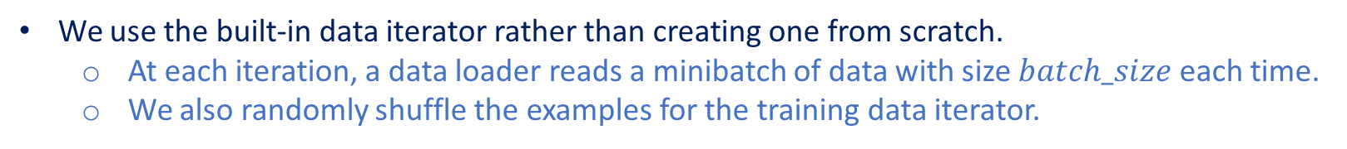
Reading a Minibatch
We use the built-in data iterator rather than creating one from scratch.
At each iteration, a data loader reads a minibatch of data with size $batch_size$ each time.
We also randomly shuffle the examples for the training data iterator.
batch_size = 256
def get_dataloader_workers(): #@save
"""Use 4 processes to read the data except for Windows."""
return 0 if sys.platform.startswith('win') else 4
# `ToTensor` converts the image data from uint8 to 32-bit floating point. It
# divides all numbers by 255 so that all pixel values are between 0 and 1
transformer = gluon.data.vision.transforms.ToTensor()
train_iter = gluon.data.DataLoader(mnist_train.transform_first(transformer),
batch_size, shuffle=True,
num_workers=get_dataloader_workers())
Let us look at the time it takes to read the training data.
timer = d2l.Timer()
for X, y in train_iter:
continue
f'{timer.stop():.2f} sec'

Slide 11
Contents
CH2
Linear Regression
Linear Regression Implementation from Scratch
Concise Implementation of Linear Regression
Softmax Regression
The Image Classification Dataset
Implementation of Softmax Regression from Scratch
Concise Implementation of Softmax Regression
Basic Elements of Linear Regression
Generating the Dataset
Generating the Dataset
Classification Problem
Reading the Dataset
Initializing Model Parameters
Initializing Model Parameters
Vectorization for Speed
Reading the Dataset
Reading the Dataset
Network Architecture
Reading a Minibatch
Defining the Softmax Operation
Softmax Implementation Revisited
The Normal Distribution and Squared Loss
Initializing Model Parameters
Defining the Model
Softmax Operation
Putting All Things Together
Defining the Model
Optimization Algorithm
From Linear Regression to Deep Networks
Defining the Model
Initializing Model Parameters
Vectorization for Minibatches
Defining the Loss Function
Training
Defining the Loss Function
Defining the Loss Function
Loss Function
Classification Accuracy
Defining the Optimization Algorithm
Defining the Optimization Algorithm
Information Theory Basics
Training
Training
Training
Model Prediction and Evaluation
Prediction

Slide 12
Putting All Things Together
Now we define the $load_data_fashion_mnist$ function that obtains and reads the Fashion-MNIST dataset.
It returns the data iterators for both the training set and validation set.
It accepts an optional argument to resize images to another shape.
def load_data_fashion_mnist(batch_size, resize=None): #@save
"""Download the Fashion-MNIST dataset and then load it into memory."""
dataset = gluon.data.vision
trans = [dataset.transforms.ToTensor()]
if resize:
trans.insert(0, dataset.transforms.Resize(resize))
trans = dataset.transforms.Compose(trans)
mnist_test = dataset.FashionMNIST(train=False).transform_first(trans)
return (gluon.data.DataLoader(mnist_train, batch_size, shuffle=True,
num_workers=get_dataloader_workers()),
gluon.data.DataLoader(mnist_test, batch_size, shuffle=False,
mnist_train = dataset.FashionMNIST(train=True).transform_first(trans)
num_workers=get_dataloader_workers()))
We test the image resizing feature of the $load_data_fashion_mnist$ function by specifying the resize argument.
train_iter, test_iter = load_data_fashion_mnist(32, resize=64)
for X, y in train_iter:
print(X.shape, X.dtype, y.shape, y.dtype)
break

Slide 13
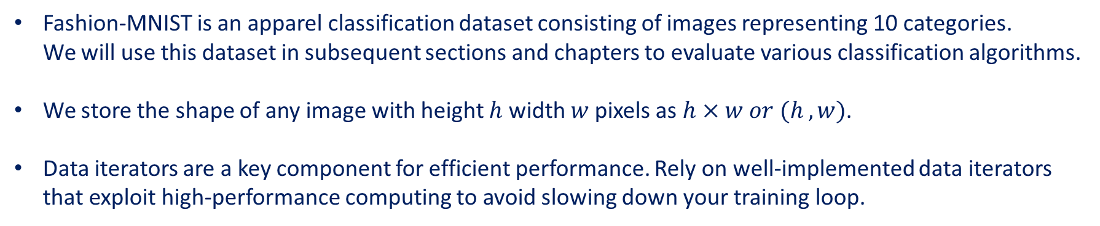
Summary
Fashion-MNIST is an apparel classification dataset consisting of images representing 10 categories. We will use this dataset in subsequent sections and chapters to evaluate various classification algorithms.
We store the shape of any image with height $h$ width $w$ pixels as $h×w or (h , w)$.
Data iterators are a key component for efficient performance. Rely on well-implemented data iterators that exploit high-performance computing to avoid slowing down your training loop.

